Slide 1
Unit -2
Fundamental of ‘c’

Slide 2
Character set
Like every other language, 'C' also has its own character set. A program is a set of instructions that, when executed, generate an output. The data that is processed by a program consists of various characters and symbols. The output generated is also a combination of characters and symbols.
A character set in 'C' is divided into,
Letters
Numbers
Special characters
White spaces (blank spaces)

Slide 3
Conti..
Following is the character set in 'C' programming:
Letters
  Uppercase characters (A-Z)
  Lowercase characters (a-z)
Numbers
  All the digits from 0 to 9
White spaces
  Blank space
  New line
  Carriage return
  Horizontal tab

Slide 4
Conti..
Special characters
  Special characters in 'C' are shown in the given table,
, (comma) | { (opening curly bracket)
. (period) | } (closing curly bracket)
; (semi-colon) | [ (left bracket)
: (colon) | ] (right bracket)
? (question mark) | ( (opening left parenthesis)
' (apostrophe) | ) (closing right parenthesis)
" (double quotation mark) | & (ampersand)
! (exclamation mark) | ^ (caret)
|(vertical bar) | + (addition)
/ (forward slash) | - (subtraction)
\ (backward slash) | * (multiplication)
~ (tilde) | / (division)
_ (underscore) | > (greater than or closing angle bracket)
$ (dollar sign) | < (less than or opening angle bracket)
% (percentage sign) | # (hash sign)

Slide 5
Token in c language
TOKEN is the smallest unit in a 'C' program. Tokens in C is the most important element to be used in creating a program in C. We can define the token as the smallest individual element in C. For `example, we cannot create a sentence without using words; similarly, we cannot create a program in C without using tokens in C.
The compiler breaks a program into the smallest possible units (tokens) and proceeds to the various stages of the compilation. A token is divided into six different types, viz, Keywords, Operators, Strings, Constants, Special Characters, and Identifiers.

Slide 6
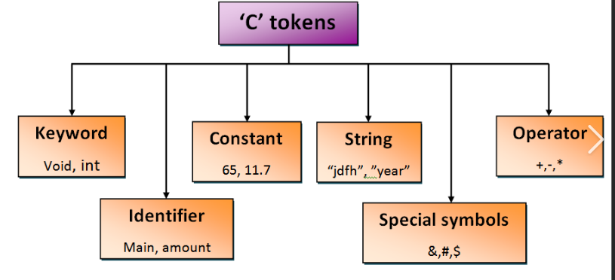
Conti..

Slide 7
Keywords in C
Keywords in C can be defined as the pre-defined or the reserved words having its own importance, and each keyword has its own functionality. Since keywords are the pre-defined words used by the compiler, so they cannot be used as the variable names. If the keywords are used as the variable names, it means that we are assigning a different meaning to the keyword, which is not allowed.

Slide 8
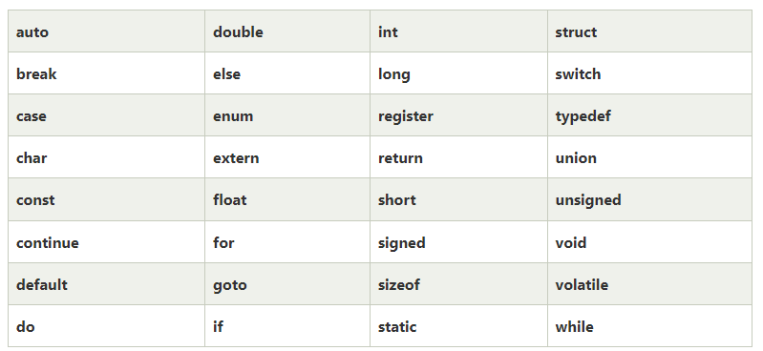
Conti..
C language supports 32 keywords given below:

Slide 9
Identifiers in C
Identifiers in C are used for naming variables, functions, arrays, structures, etc. Identifiers in C are the user-defined words. It can be composed of uppercase letters, lowercase letters, underscore, or digits, but the starting letter should be either an underscore or an alphabet. Identifiers cannot be used as keywords.

Slide 10
Conti..
Following rules must be followed for identifiers:
First character: The first character of the identifier should necessarily begin with either an alphabet or an underscore. It cannot begin with a digit.
No special characters: C does not support the use of special characters while naming an identifier. For instance, special characters like comma or punctuation marks can’t be used.
No keywords: The use of keywords as identifiers is strictly prohibited, as they are reserved words which we have already discussed.
No white space: White spaces include blank spaces, newline, carriage return, and horizontal tab, which can’t be used.
Word limit: The identifier name can have an arbitrarily long sequence that should not exceed 31 characters, otherwise, it would be insignificant.
Case sensitive: Uppercase and lowercase characters are treated differently.

Slide 11
Data Type in C
Data types in C refer to the characteristics of data stored into a variable. .
Clearly, from the above discussion, you might have inferred that memory occupied by different data types would be different. Therefore, a different amount of space in the computer memory would be allocated for them and hence the run time of the program would be reduced, increasing the efficiency of the program.

Slide 12
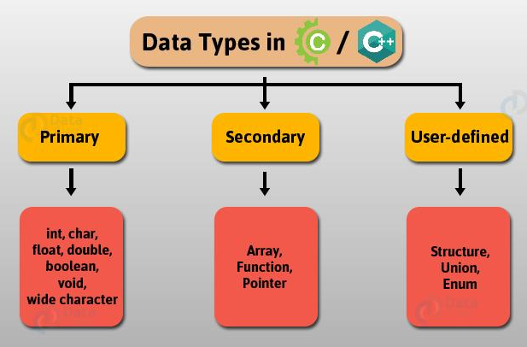
Types of Data Types in C
According to the conventional classification, these are data types in C language-

Slide 13
Primary Data Types in C
Primary (Fundamental) data types in C programming includes the 4 most basic data types, that is:
int: It is responsible for storing integers. The memory it occupies depends on the compiler (32 or 64 bit). In general, int data type occupies 4 bytes of memory when working with a 32-bit compiler.
float: It is responsible for storing fractions or digits up to 7 decimal places. It is usually referred to as a single-precision floating-point type. It occupies 4 bytes of memory
char: It can be used to store a set of all characters which may include alphabets, numbers and special characters. It occupies 1 byte of memory being the smallest addressable unit of a machine containing a fundamental character set.
double: It is responsible for storing fractions or digits up to 15-16 decimal places. It is usually referred to as a double-precision floating-point type.
void (Null) data type: It indicates zero or no return value. It is generally used to assign the null value while declaring a function.

Slide 14
Conti…
Along with data types, comes modifiers. Modifiers basically alter the function of a data type and make it more specific by the inclusion of additional provisions. These include:
Signed: It is used to store zero, positive or negative values.
Unsigned: It can store only zero or positive values.
Long: It is used to store large integer numbers. The size of the long type is 8 bytes.
Short: It is used to store small integer numbers. Its size is of 2 Bytes

Slide 15
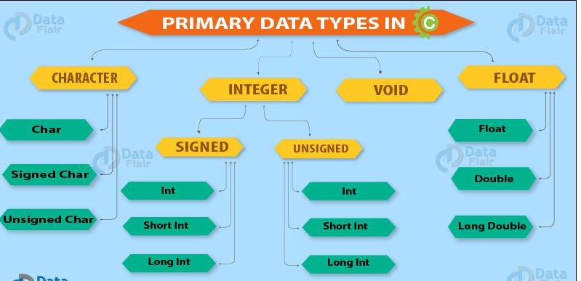
Conti..

Slide 16
Conti..
Here is a table that would specify the range of various data primary data types along with their modifiers. It is in accordance with a 32-bit compiler.
Data Type | Memory (In Bytes) | Format Specifiers | Range
int | 4 | %d | -2,147,483,648 to 2,147,483,647
short int | 2 | %hd | -32,768 to 32,767
unsigned int | 4 | %u | 0 to 4,294,967,295
unsigned short int | 2 | %hu | 0 to 65,535
long int | 4 | %ld | -2,147,483,648 to 2,147,483,647
unsigned long int | 4 | %lu | 0 to 4,294,967,295
long long int | 8 | %lld | -(263) to (263)-1
unsigned long long int | 8 | %llu | 0 to 18,446,744,073,709,551,615
char | 1 | %c | -128 to 127
Signed char | 1 | %c | -128 to 127
Unsigned char | 1 | %c | 0 to 255
float | 4 | %f | –
double | 8 | %lf | –
long double | 12 | %Lf | –

